Slide 1
Chapter 4
Stochastic calculus
報告者：何俊儒

Slide 2
4.1 Introduction

Slide 3
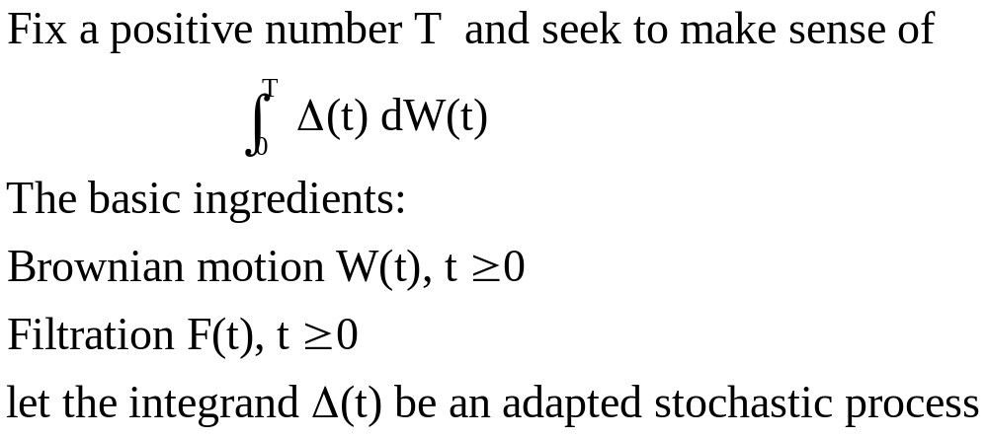
4.2 Ito’s Integral for Simple Integrands
(4.2.1)

Slide 4
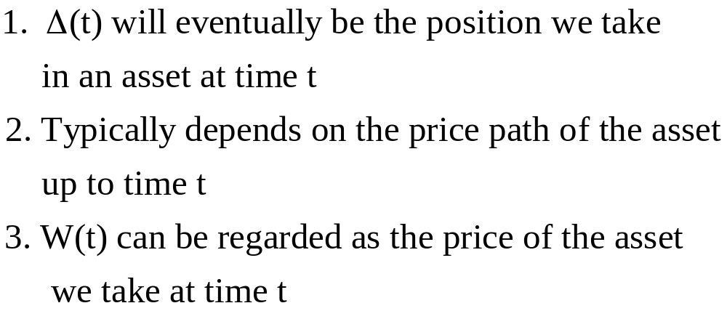
Reason for doing this:

Slide 5
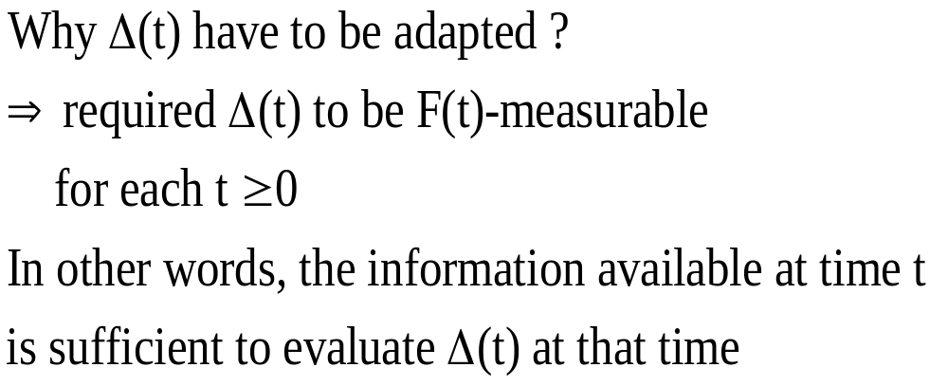

Slide 6
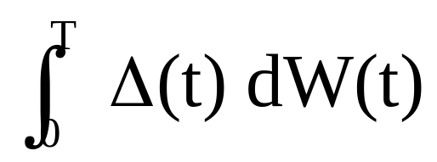
Trying to assign meaning to the Ito integral
(4.2.1)
We face the problem is that Brownian motion paths cannot be differentiated with respect to time

Slide 7
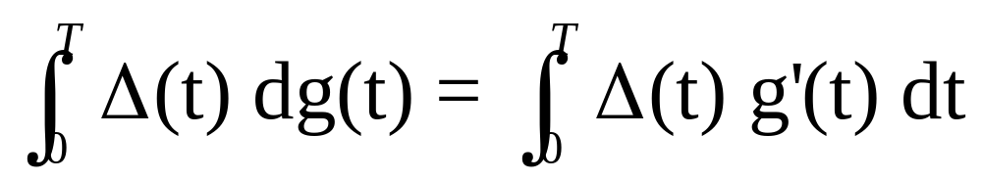
If g(t) is a differentiable function
Define
The right-hand side is an ordinary (Lebesgue) integral with respect to time

Slide 8
4.2.1 Construction of the Integral
To define the integral (4.2.1), Ito devised the following way around the non-differentiability of the Brownian motion paths
We first define the simple integrands, and then extend it to non-simple integrands as a limit of the integral of simple integrands

Slide 9
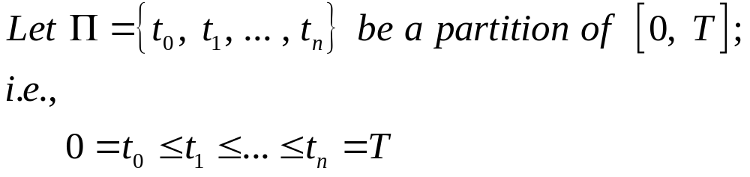
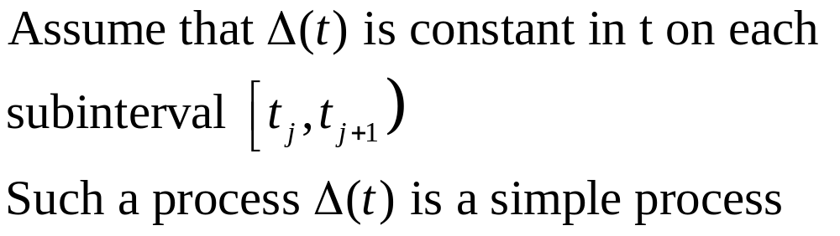
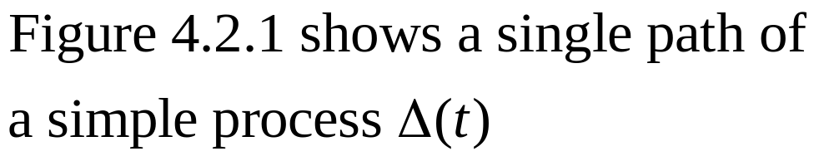

Slide 10
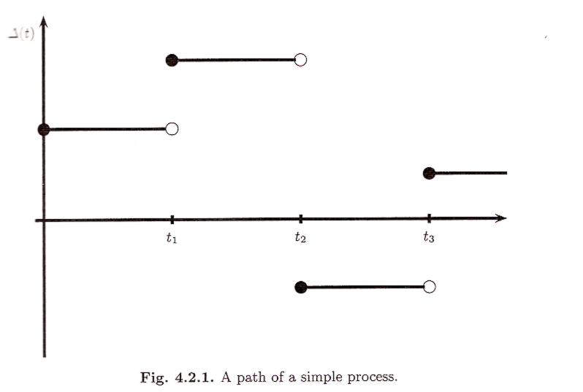

Slide 11
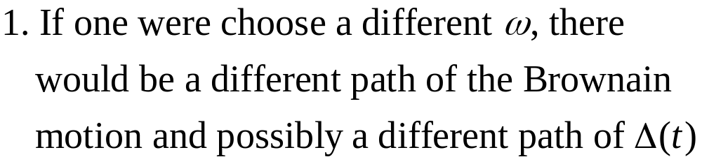
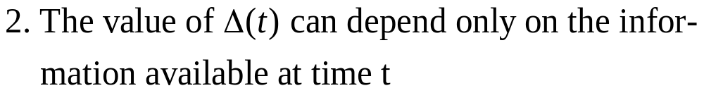
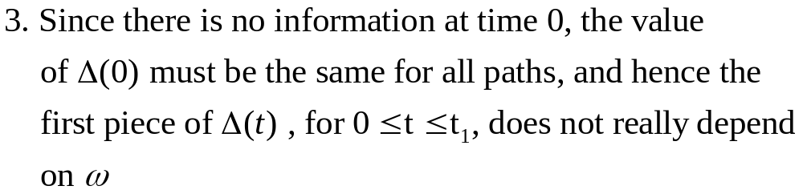
Note

Slide 12
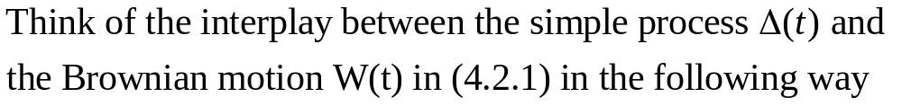
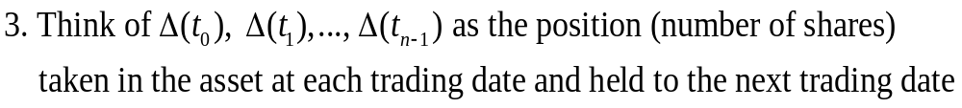

Slide 13
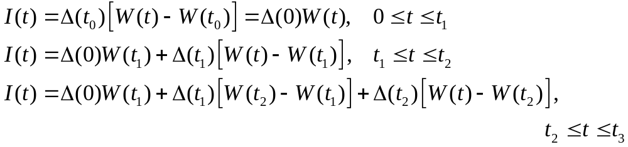
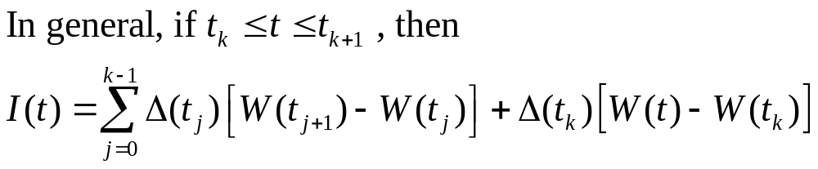
The gain from trading at each time t is given by
(4.2.2)

Slide 14
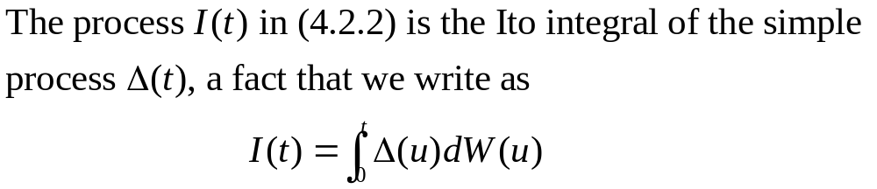

Slide 15
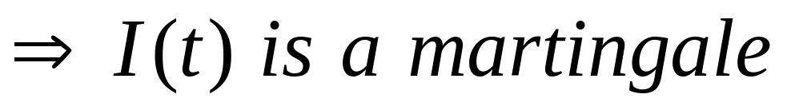
4.2.2 Properties of the Integral
The Ito integral (4.2.2) is defined as the
gain from trading in the martingale W(t)
2.I(t) can be thought of as a process in its
upper limit of integration t, and has no
tendency to rise or fall

Slide 16
Theorem 4.2.1.
The Ito integral defined by (4.2.2) is a martingale

Slide 17
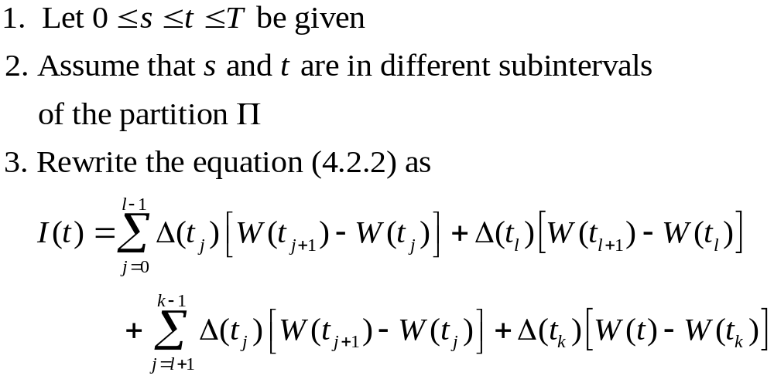
Proof:
(4.2.3)

Slide 18
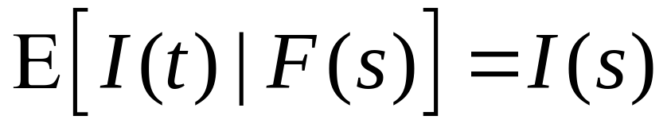
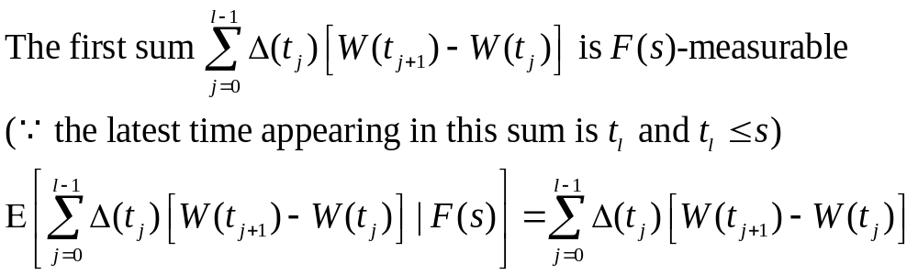
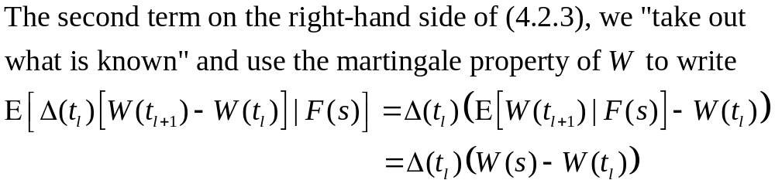
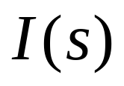
We must show that
(4.2.4)
(4.2.5)
Adding (4.2.4) and (4.2.5), we obtain

Slide 19
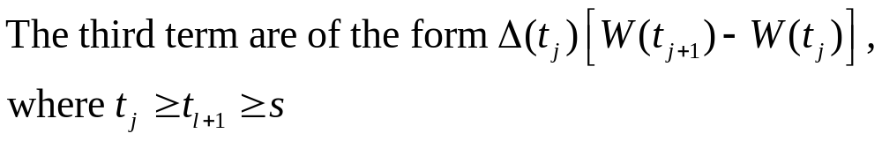
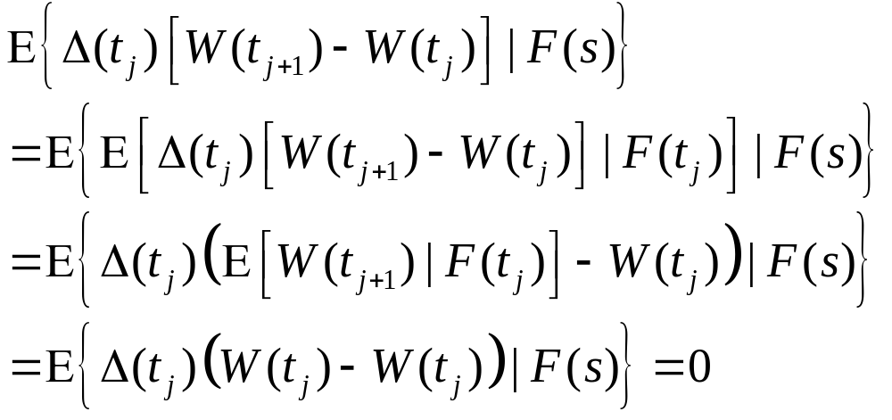
To show that the conditional expectations of the third and fourth terms on the right-hand side of (4.2.3) are zero
Iterated conditioning

Slide 20
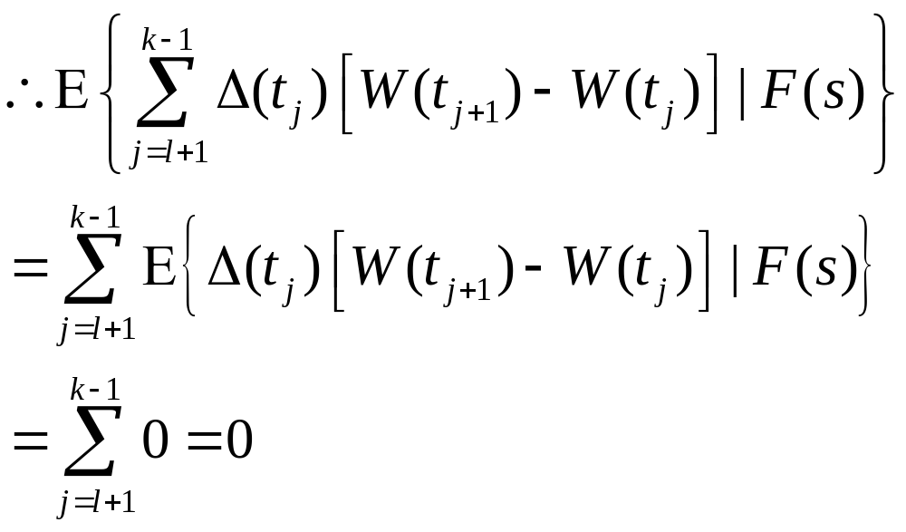

Slide 21
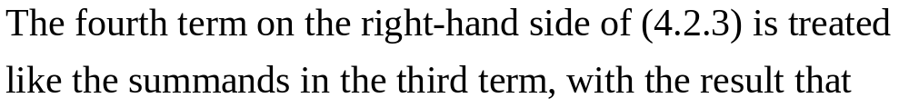
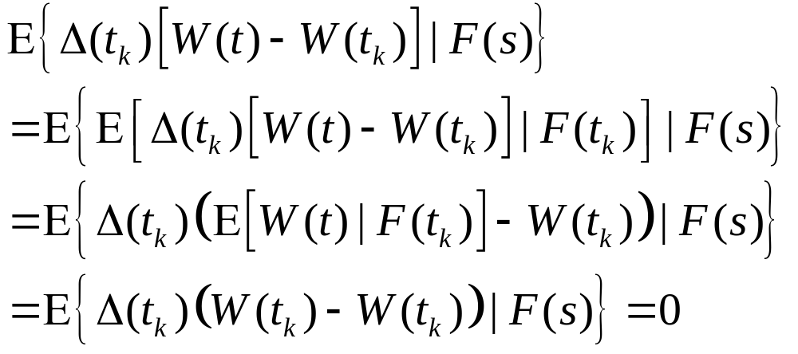

Slide 22
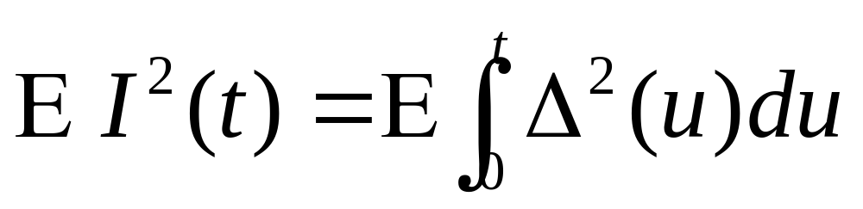
Theorem 4.2.2. (Ito isometry)
The Ito integral defined by (4.2.2) satisfies
(4.2.6)

Slide 23
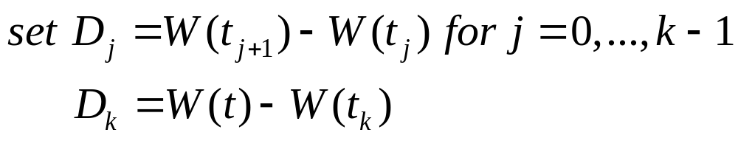
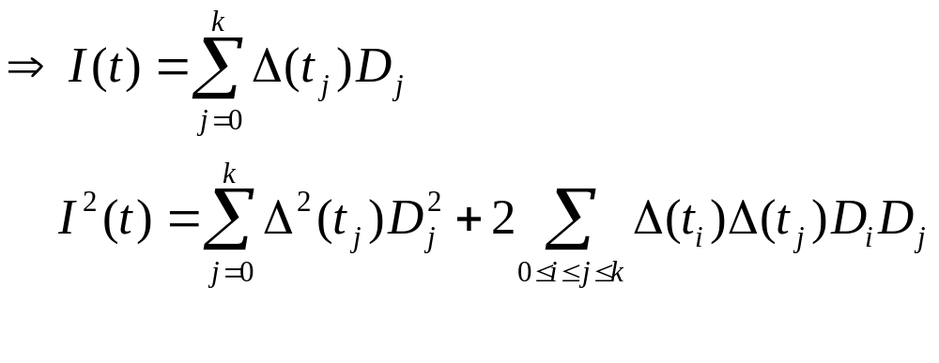
Proof:

Slide 24
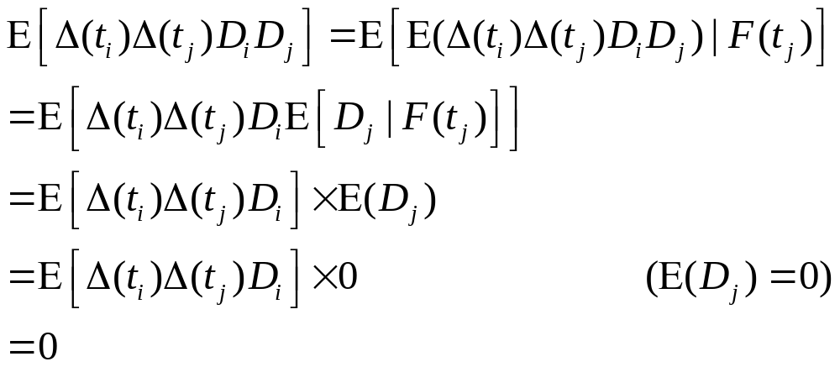

Slide 25
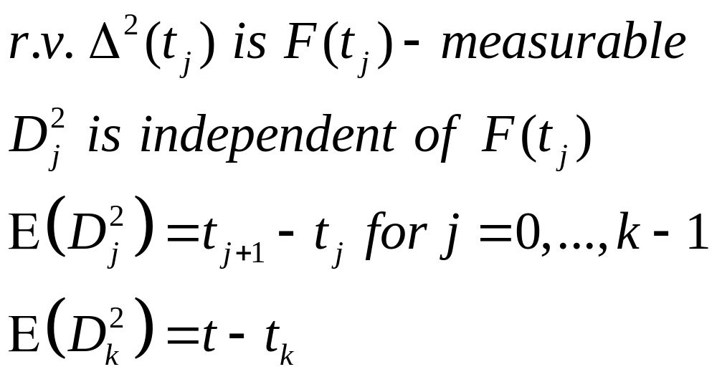
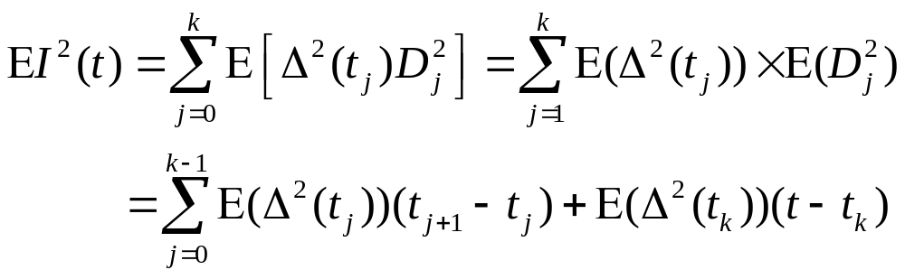
(4.2.7)

Slide 26
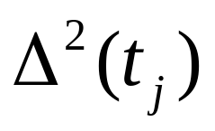
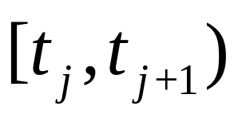
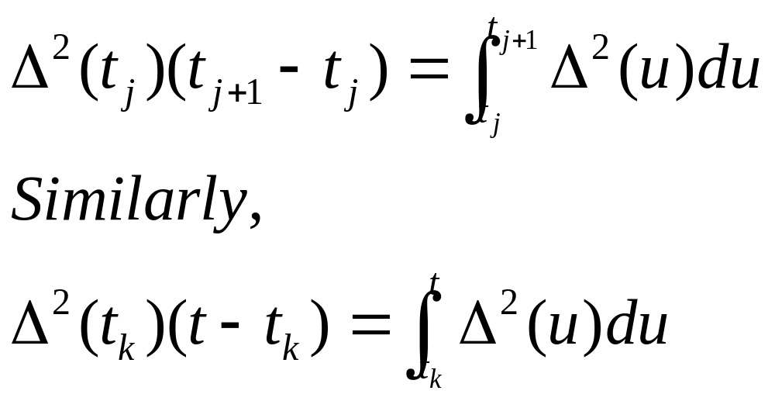
Note that is constant on the interval
, and hence
Substitute the above into equation (4.2.7)
to obtain the following equations

Slide 27
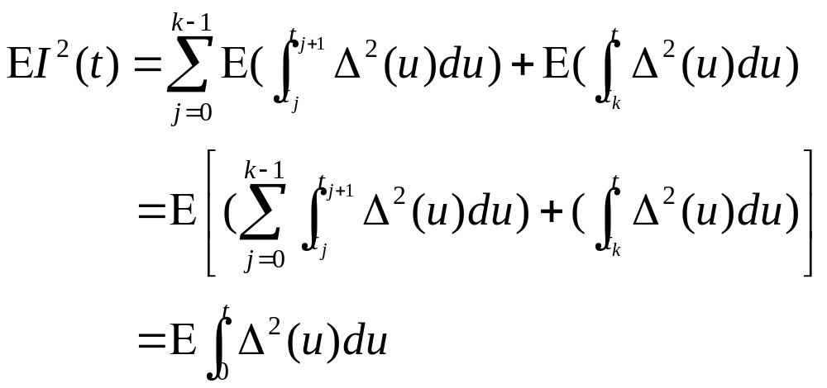

Slide 28
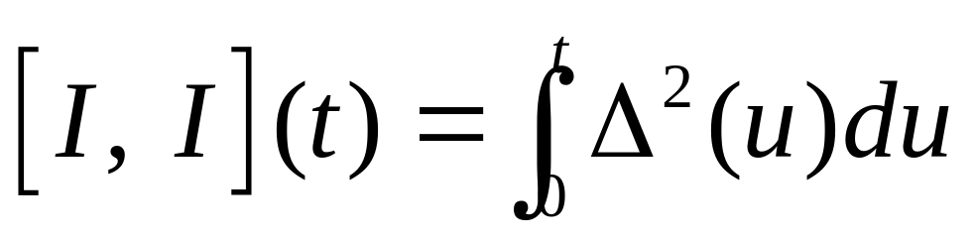
Theorem 4.2.3.
The quadratic variation accumulated up to time t by the Ito integral (4.2.2) is
(4.2.9)

Slide 29
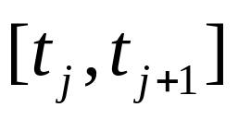
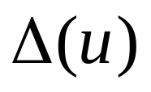
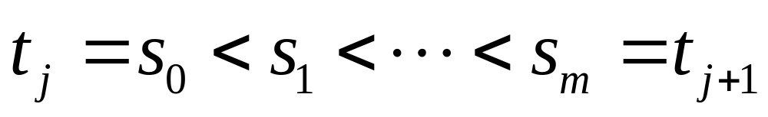
Proof:
On one of the subintervals which is constant
We first compute the quadratic variation accumulated by Ito integral, we choose partition points

Slide 30
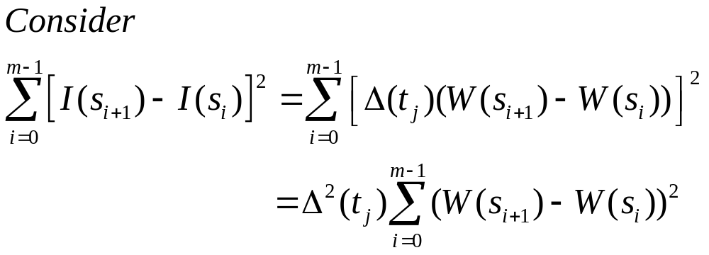
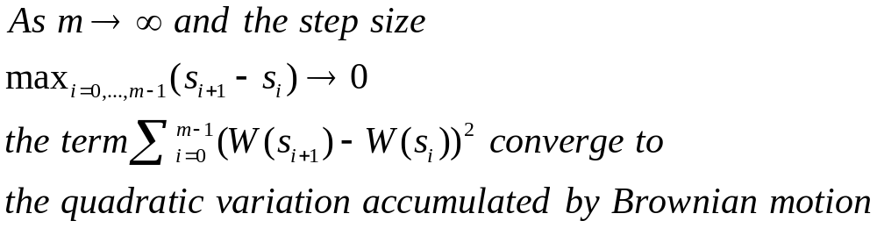
(4.2.9)

Slide 31
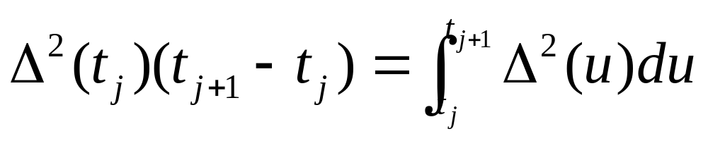
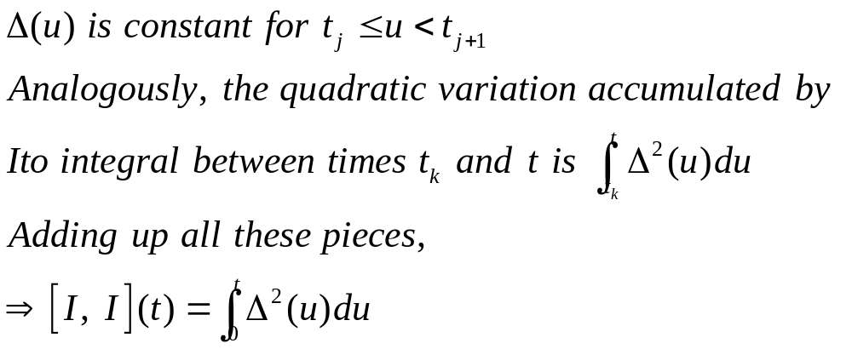
The limit of (4.2.9) is

Slide 32
The difference between Theorem 4.2.2 and 4.2.3
The quadratic variation
  is computed path-by-path, and result can depend on the path
  can be regard as a measure of risk
  depend on the size of the position we take
The variance of I(t)
  Is an average over all possible paths of quadratic variation
  can’t be random

Slide 33
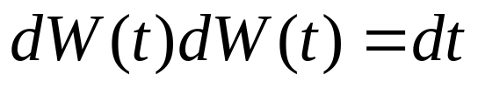
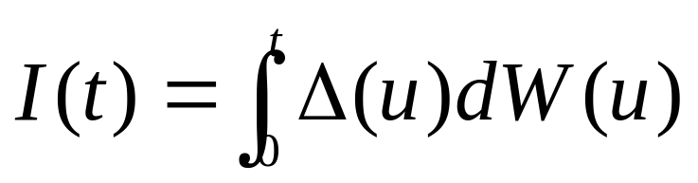
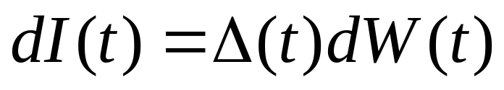
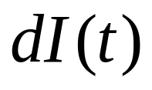

Recall the equation (3.4.10),
means that Brownian motion accumulates quadratic variation at rate one per unit time
And the Ito integral formula
can be written in differential form as
Using (3.4.10) to square
means that the Ito integral I(t) accumulates quadratic variation at rate per unit time

Slide 34


Remark 4.2.4 (on notation)
(4.2.12)
(4.2.13)

